Slide 1
Stack and Queue

Slide 2
Content
Stack using arrays
Stack using linked lists
Queue using arrays
Queue using linked lists
Applications

Slide 3
Stack
It is a linear data structure that follows a particular order in which the operations are performed.
LIFO (Last In First Out)
This strategy states that the element that is inserted last will come out first. You can take a pile of plates kept on top of each other as a real-life example. The plate which we put last is on the top and since we remove the plate that is at the top, we can say that the plate that was put last comes out first.

Slide 4
Basic Operations
push() to insert an element into the stack
pop() to remove an element from the stack
top() Returns the top element of the stack.
isEmpty() returns true is stack is empty else false
size() returns the size of stack

Slide 5
Array Code
#include <stdio.h>
int stack[100],n,top=-1;
void push ()
{
int val;
if (top == n )
printf("\n Overflow");
else
{
printf("Enter the value?");
scanf("%d",&val);
top = top +1;
stack[top] = val;
}
}
void pop ()
{
if(top == -1)
printf("Underflow");
else
top = top -1;
}

Slide 6
Contd.
void show()
{
for (i=top;i>=0;i--)
{
printf("%d\n",stack[i]);
}
if(top == -1)
{
printf("Stack is empty");
}
}

Slide 7
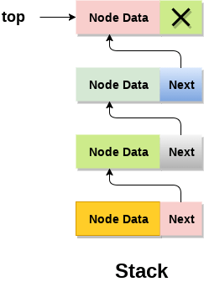
Linked List Implementation of Stack

Slide 8
Push()
Create a node first and allocate memory to it.
If the list is empty then the item is to be pushed as the start node of the list. This includes assigning value to the data part of the node and assign null to the address part of the node.
If there are some nodes in the list already, then we have to add the new element in the beginning of the list (to not violate the property of the stack). For this purpose, assign the address of the starting element to the address field of the new node and make the new node, the starting node of the list.

Slide 9
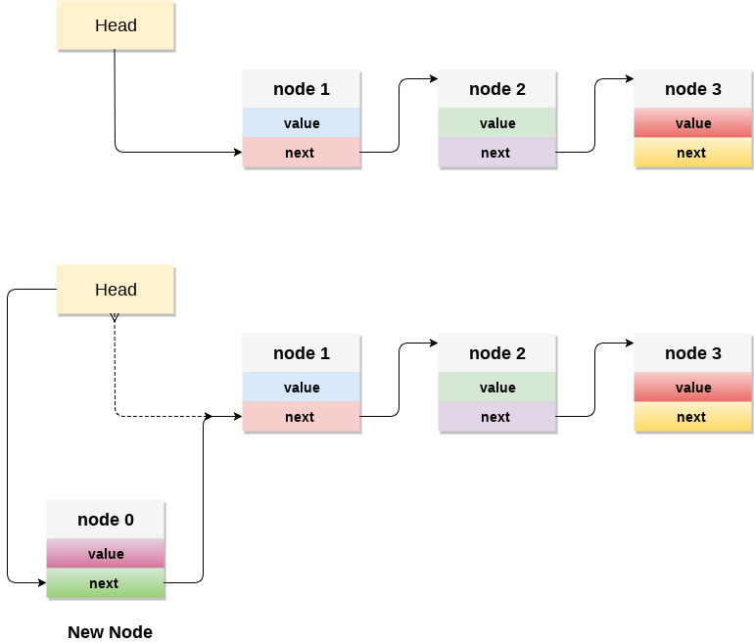
Contd.

Slide 10
Code
void push ()
{
int val;
struct node *ptr =(struct node*)malloc(sizeof(struct node));
if(ptr == NULL)
{
printf("not able to push the element");
}
else
{
printf("Enter the value");
scanf("%d",&val);
if(head==NULL)
{
ptr->val = val;
ptr -> next = NULL;
head=ptr;
}
else
{
ptr->val = val;
ptr->next = head;
head=ptr;
}
printf("Item pushed");
}
}

Slide 11
Pop()
Check for the underflow condition: The underflow condition occurs when we try to pop from an already empty stack. The stack will be empty if the head pointer of the list points to null.
Adjust the head pointer accordingly: In stack, the elements are popped only from one end, therefore, the value stored in the head pointer must be deleted and the node must be freed. The next node of the head node now becomes the head node.

Slide 12
Code
void pop()
{
int item;
struct node *ptr;
if (head == NULL)
{
printf("Underflow");
}
else
{
item = head->val;
ptr = head;
head = head->next;
free(ptr);
printf("Item popped");
}
}

Slide 13
Display()
Copy the head pointer into a temporary pointer.
Move the temporary pointer through all the nodes of the list and print the value field attached to every node.

Slide 14
Code
void display()
{
int i;
struct node *ptr;
ptr=head;
if(ptr == NULL)
{
printf("Stack is empty\n");
}
else
{
printf("Printing Stack elements \n");
while(ptr!=NULL)
{
printf("%d\n",ptr->val);
ptr = ptr->next;
}
}
}

Slide 15
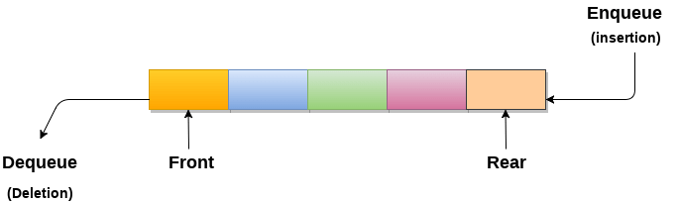
Queue
A queue can be defined as an ordered list which enables insert operations to be performed at one end called REAR and delete operations to be performed at another end called FRONT.
Queue is referred to be as First In First Out list.
For example, people waiting in line for a rail ticket form a queue.

Slide 16
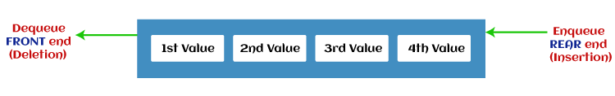
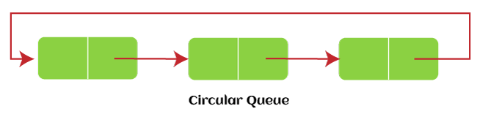
Types
Simple Queue or Linear Queue
Circular Queue

Slide 17
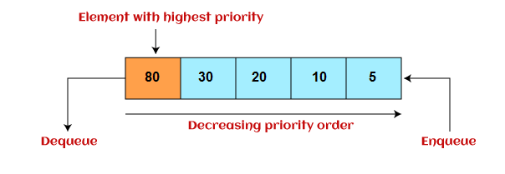
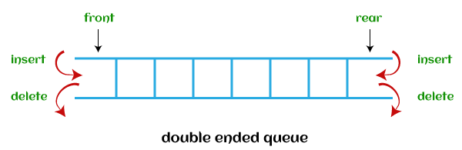
Contd.
Priority Queue
Double Ended Queue (or Deque)

Slide 18
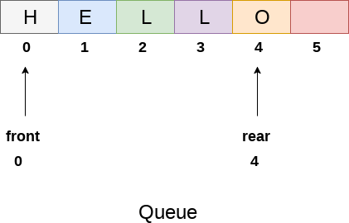
Queue using Arrays

Slide 19
Enqueue Code
void insert (int queue[], int max, int front, int rear, int item)
{
if (rear + 1 == max)
{
printf("overflow");
}
else
{
if(front == -1 && rear == -1)
{
front = 0;
rear = 0;
}
else
{
rear = rear + 1;
}
queue[rear]=item;
}
}

Slide 20
Dequeue Code
int delete (int queue[], int max, int front, int rear)
{
int y;
if (front == -1 || front > rear)
{
printf("underflow");
}
else
{
y = queue[front];
if(front == rear)
{
front = rear = -1;
else
front = front + 1;
}
return y;
}
}

Slide 21
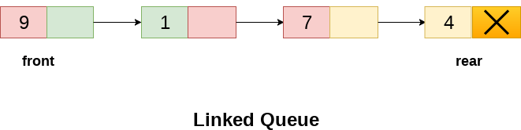
Queue using Linked List

Slide 22
Enqueue Code
void insert(struct node *ptr, int item; )
{
ptr = (struct node *) malloc (sizeof(struct node));
if(ptr == NULL)
{
printf("\nOVERFLOW\n");
return;
}
else
{
ptr -> data = item;
if(front == NULL)
{
front = ptr;
rear = ptr;
front -> next = NULL;
rear -> next = NULL;
}
else
{
rear -> next = ptr;
rear = ptr;
rear->next = NULL;
}
}
}

Slide 23
Dequeue Code
void delete (struct node *ptr)
{
if(front == NULL)
{
printf("\nUNDERFLOW\n");
return;
}
else
{
ptr = front;
front = front -> next;
free(ptr);
}
}

Slide 24
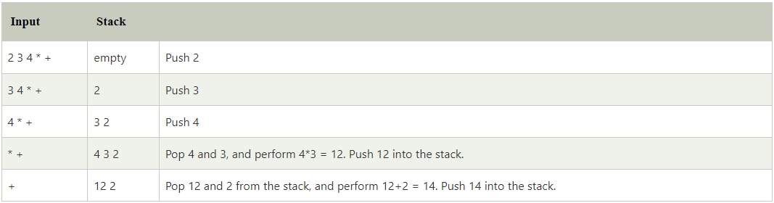
Applications
postfix expression evaluation 2 3 4 * +

Slide 25
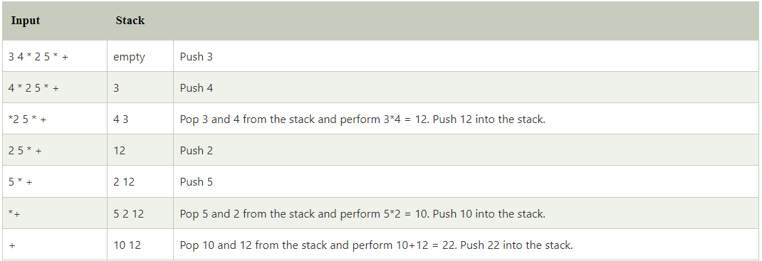
Contd.
3 4 * 2 5 * +

Slide 26
Conversion
Print the operand as they arrive.
If the stack is empty or contains a left parenthesis on top, push the incoming operator on to the stack.
If the incoming symbol is '(', push it on to the stack.
If the incoming symbol is ')', pop the stack and print the operators until the left parenthesis is found.
If the incoming symbol has higher precedence than the top of the stack, push it on the stack.
If the incoming symbol has lower precedence than the top of the stack, pop and print the top of the stack. Then test the incoming operator against the new top of the stack.
If the incoming operator has the same precedence with the top of the stack then use the associativity rules. If the associativity is from left to right then pop and print the top of the stack then push the incoming operator. If the associativity is from right to left then push the incoming operator.
At the end of the expression, pop and print all the operators of the stack.

Slide 27
Example
Infix expression: K + L - M*N + (O^P) * W/U/V * T + Q

Slide 28
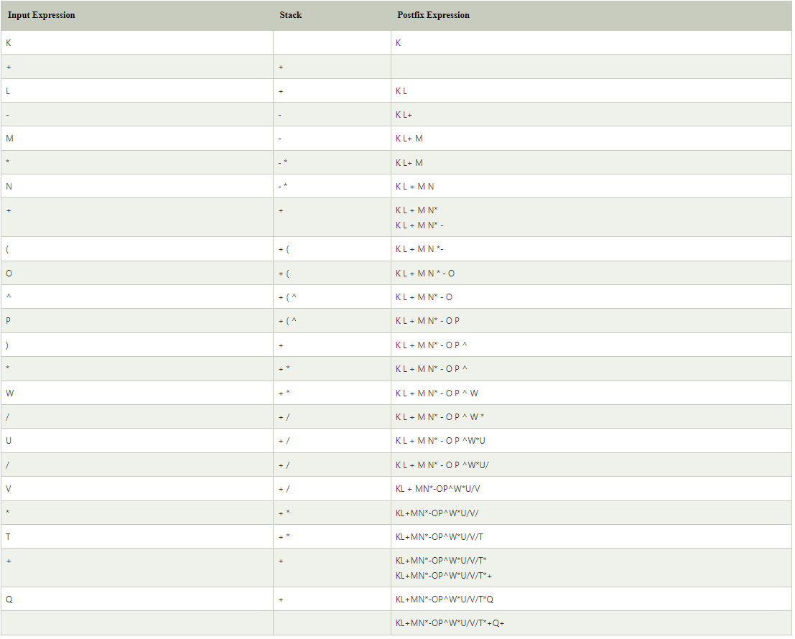

Slide 29
Evaluation of prefix expression
EVALUATE_PREFIX(STRING)
Step 1: Put a pointer P at the end of the end
Step 2: If character at P is an operand push it to Stack
Step 3: If the character at P is an operator pop two
elements from the Stack. Operate on these elements
according to the operator, and push the result
back to the Stack
Step 4: Decrement P by 1 and go to Step 2 as long as there
are characters left to be scanned in the expression.
Step 5: The Result is stored at the top of the Stack,
return it
Step 6: End

Slide 30
Example: +9*26
Character Scanned | Stack | Explanation
----------------------------------------------------------------------------------------------------------------
6 6 6 is an operand,
push to Stack
2 6 2 2 is an operand,
push to Stack
* 12 (6*2) * is an operator,
pop 6 and 2, multiply
them and push result
to Stack
9 12 9 9 is an operand, push
to Stack
+ 21 (12+9) + is an operator, pop
12 and 9 add them and
push result to Stack

Slide 31
Conversion to prefix
Example: K + L - M * N + (O^P) * W/U/V * T + Q
Step 1: If we are converting the expression from infix to prefix, we need first to reverse the expression. The Reverse expression would be:
Q + T * V/U/W * ) P^O(+ N*M - L + K

Slide 32
